Slide 2
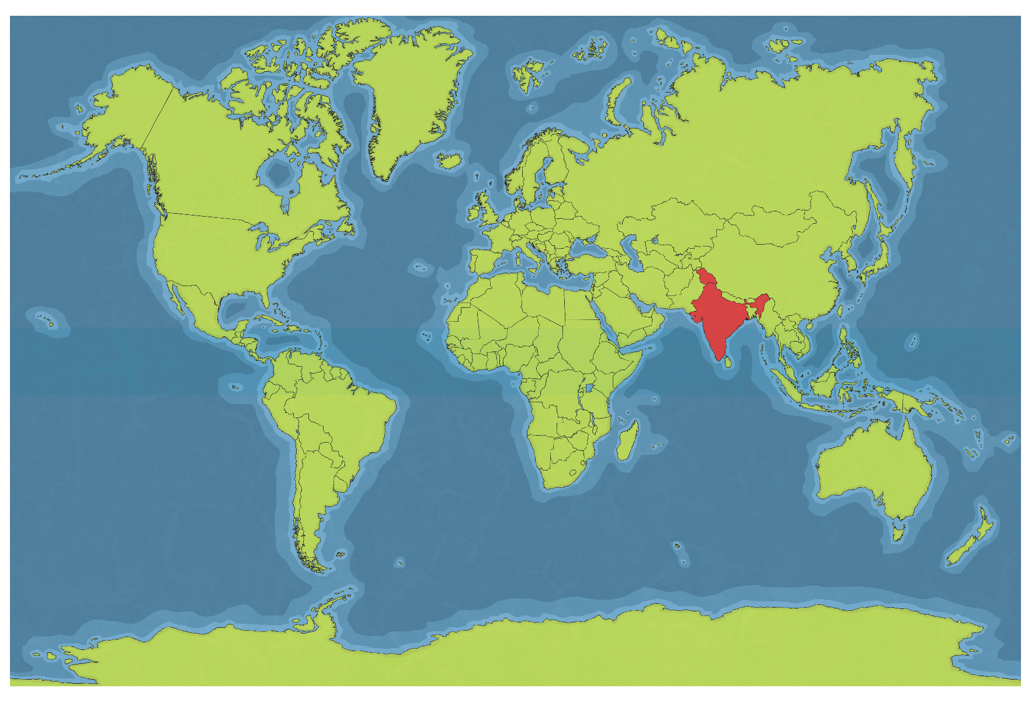
India’s Location
India is located in Asia. It is sometimes referred to as a subcontinent. It is located by the Indus River.

Slide 3
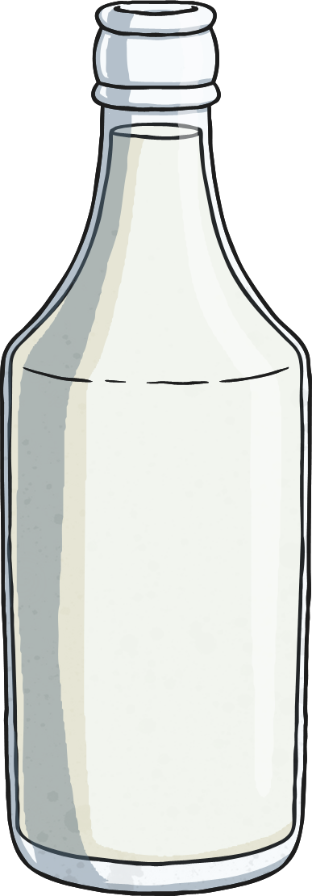
Facts About India
India’s official name is the “Republic of India."
India has the second largest population in the world.
India is the oldest civilization in the world.
India produces the most milk in the world.

Slide 4
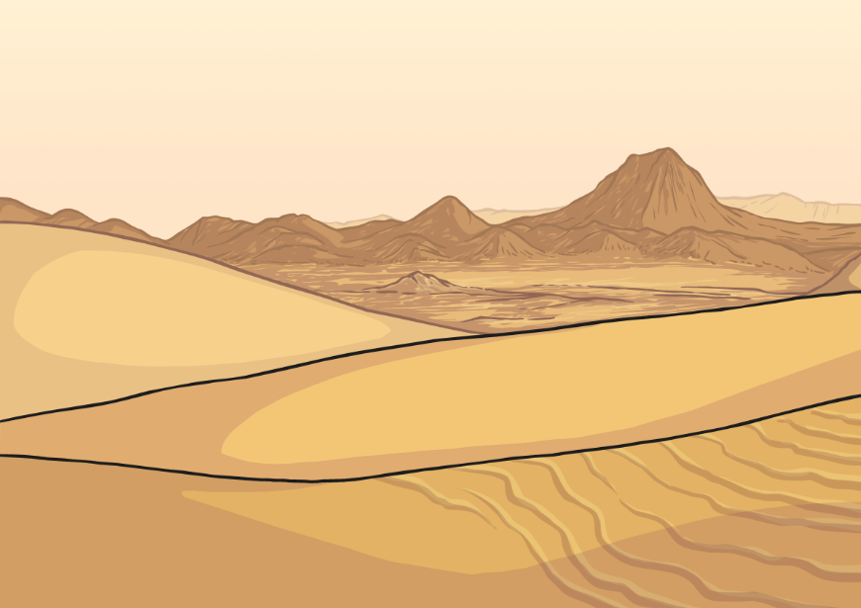
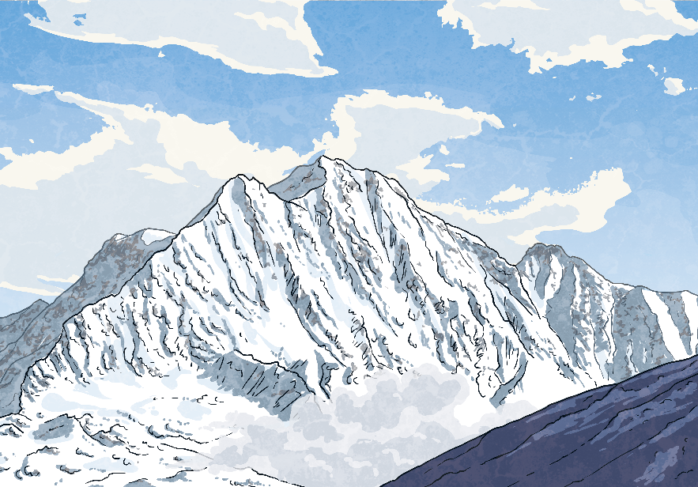
India’s Geography
India has a large desert called the Thar Desert.
India also borders the Himalayan mountain range, the highest mountain range in the world.
Like the United States, India is divided into states. India has 29 states. It also has seven union territories.

Slide 5
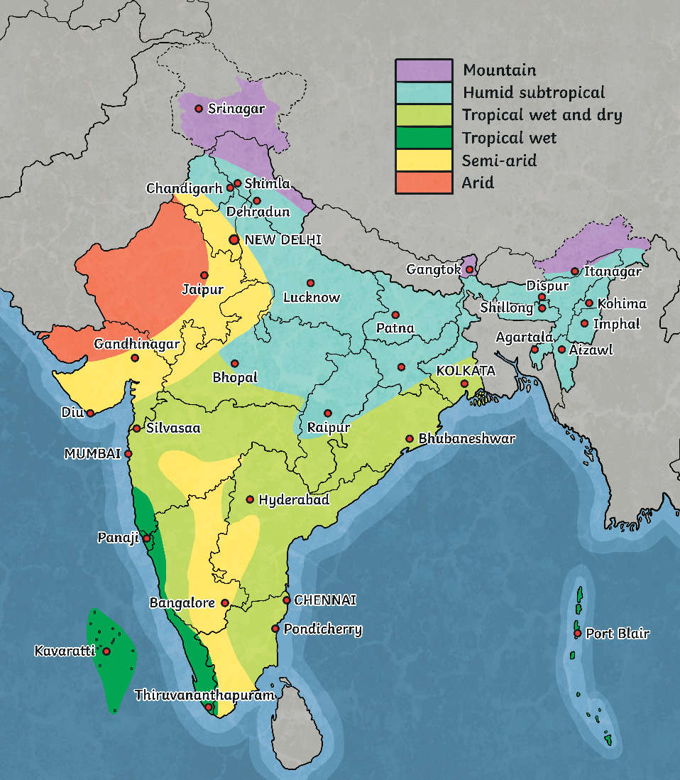
India’s Climate
Most of India is classified as tropical climate.
India has many climates because it is so large in area.
Some areas of India have an arid climate, some have a humid climate, and some even have a glacial climate.

Slide 6
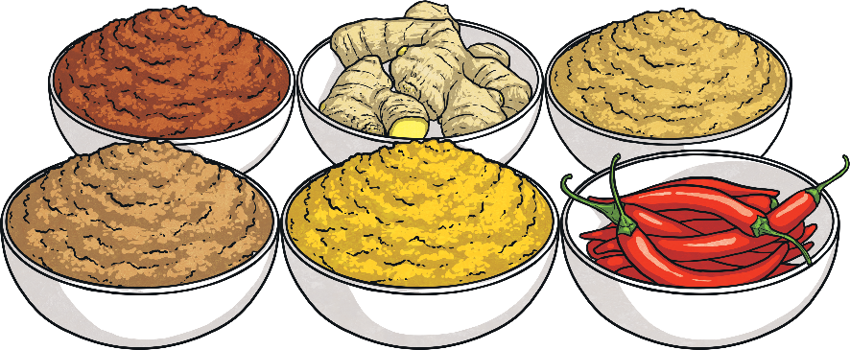
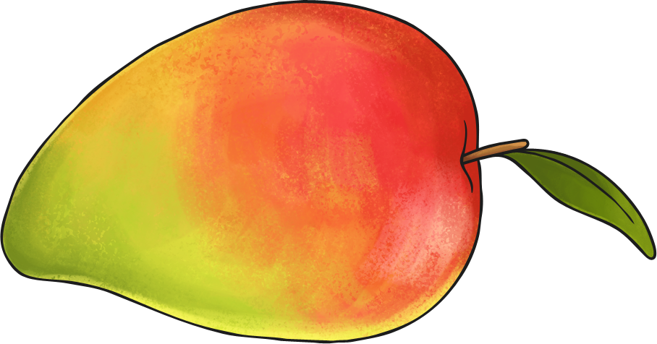
India’s Food
Since India is so diverse, its food is varied.
Rice is the staple grain used in many dishes.
Lentils are also very popular.
As India is famous for its spices, food from India usually contains spices.
Common spices are curry, turmeric, and cinnamon. Garam masala is a popular spice mixture.
Mangoes and other tropical fruit are also very common in India.

Slide 7
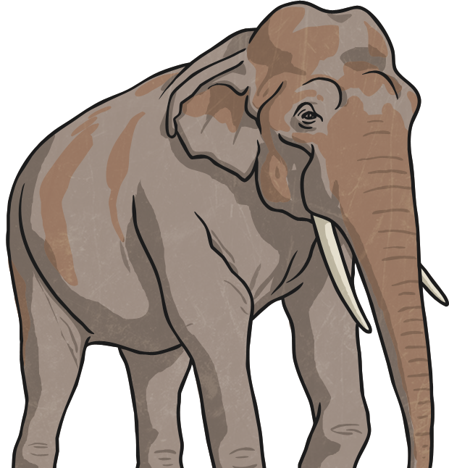
India’s Animals
India is home to many animals including:
the Bengal tiger
the Indian elephant
the Indian rhinoceros
the Indian leopard
the sloth bear
the wild water buffalo
the red panda

Slide 8
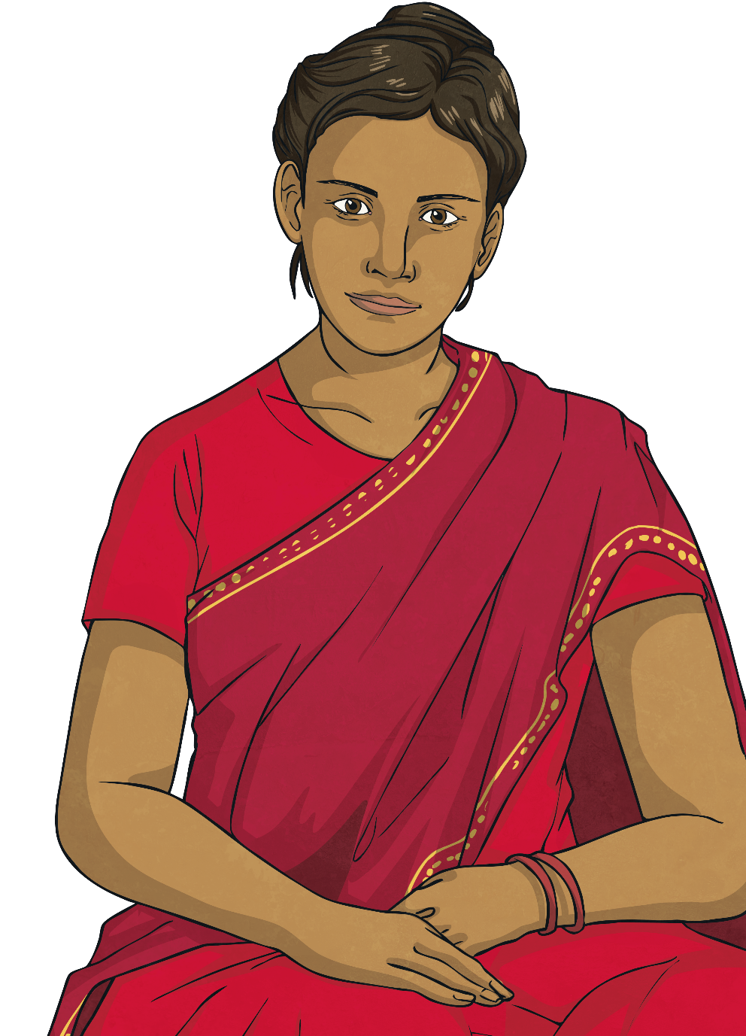
India’s Clothing
Religion impacts clothing in India.
Linen and silk are popular fabrics of many Indian clothes.
An example of traditional clothing for women is the sari. It is a draped robe-like dress.
A dhoti is a traditionally draped cloth for men.
twinkl.com

Slide 9
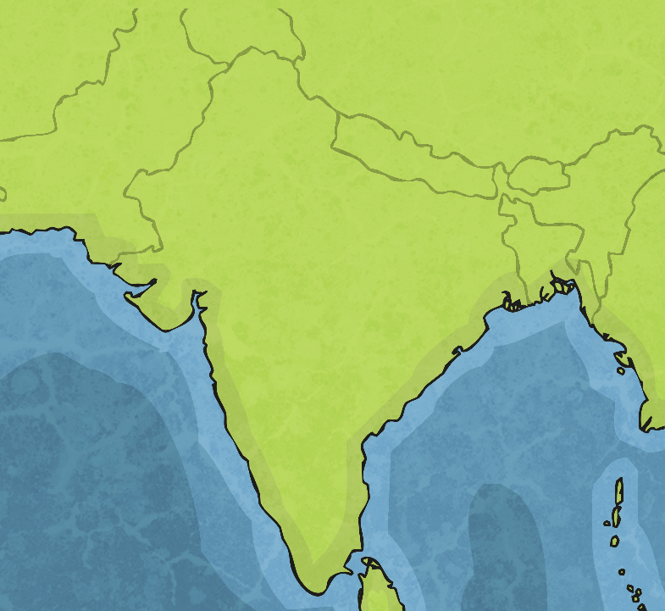
Mumbai
Mumbai is India’s largest city in terms of population.
Mumbai was formerly named Bombay.
It is named after a temple and had the first train in India.
Mumbai is also known as Bollywood (after Hollywood) because it produces a great deal of Indian movies.
Mumbai

Slide 10
Delhi
Delhi has over 11 million people. It is the second-largest city in India in terms of population.
Delhi is the largest city of India in terms of area.
Delhi is home to the largest spice market in Asia.
New Delhi is India’s capital and is in the south of Delhi.
Delhi

Slide 11
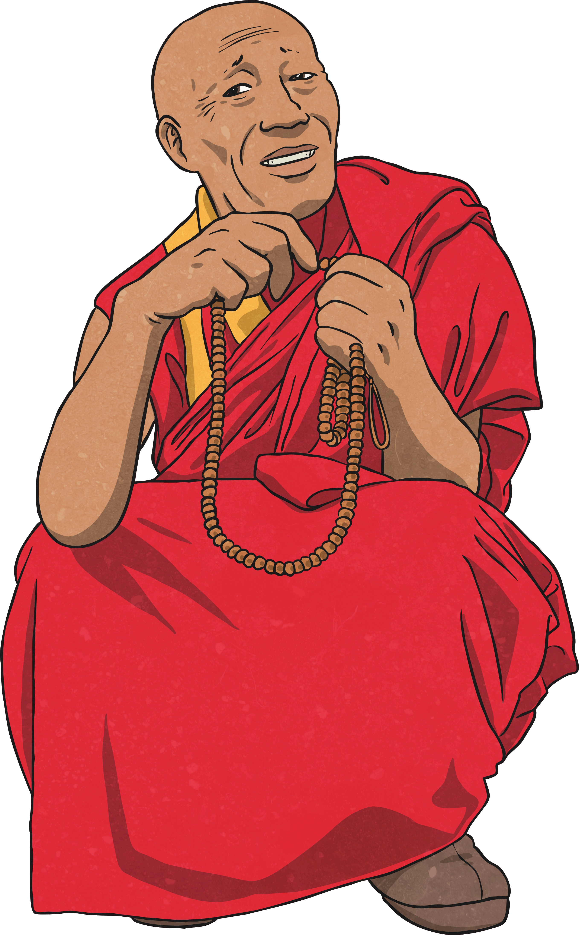
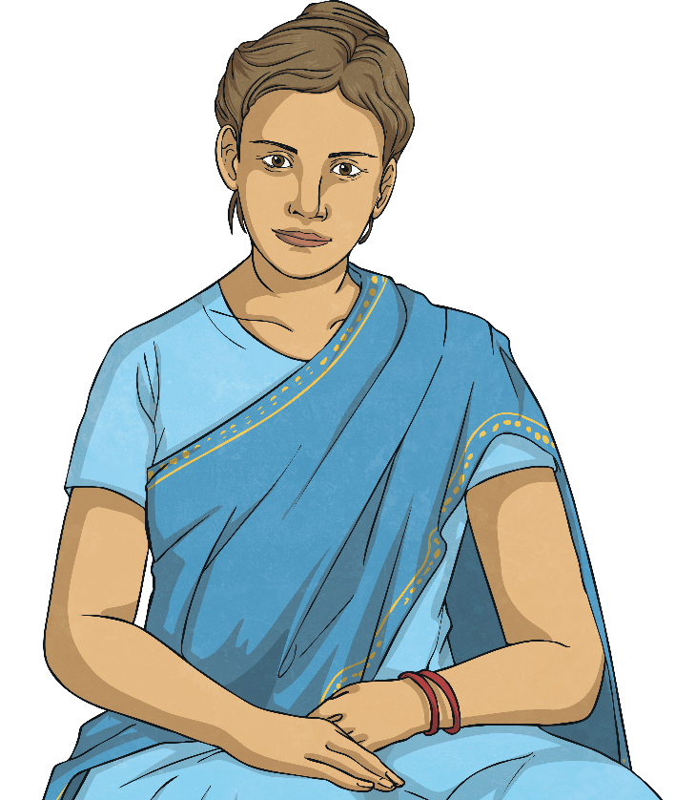
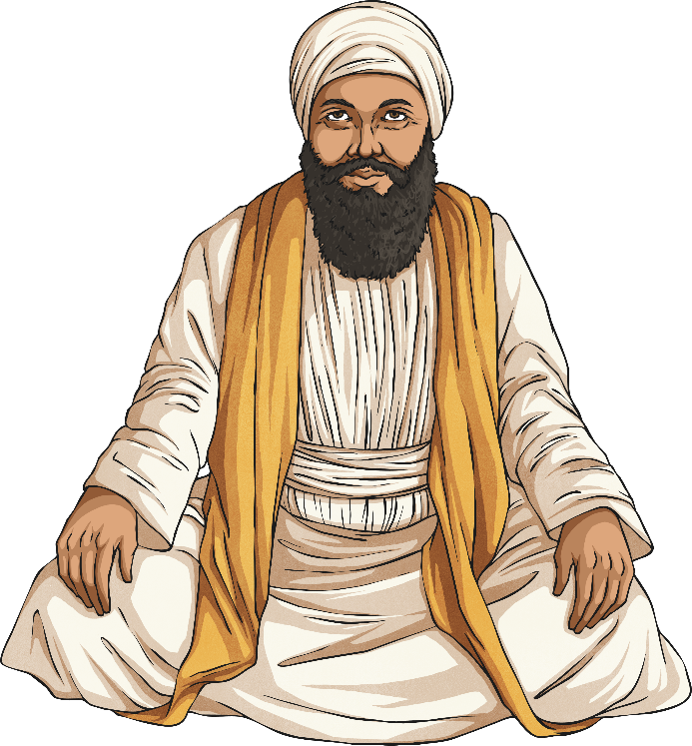
India’s Culture
India’s culture is very diverse. It includes many different people from different backgrounds.
India has many religions, including Hinduism, Buddhism, Sikhism, Islam, and Christianity.

Slide 12
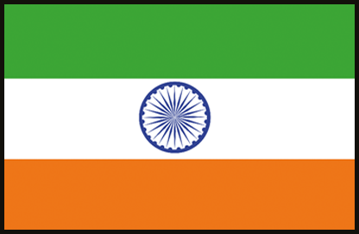
India’s Culture
India’s official language is Hindi.
Many people also speak English because India was once a British colony.

Slide 13
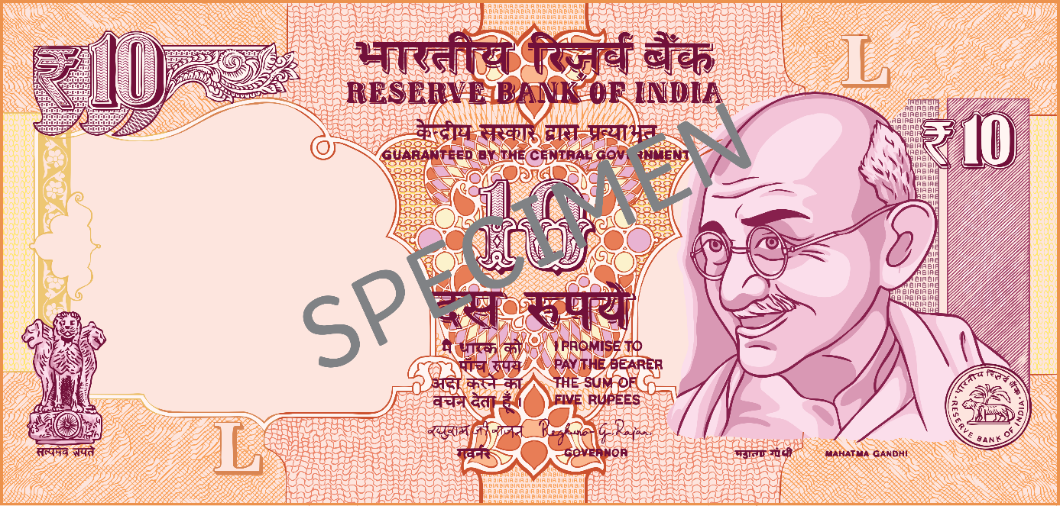
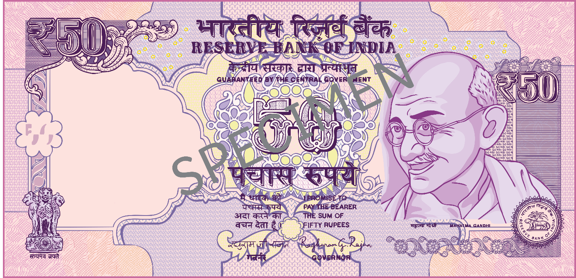
India’s Money
Rupees are the currency used in India.
The symbol is ₹.
India’s money is very colourful compared to the Great Britain.

Slide 14
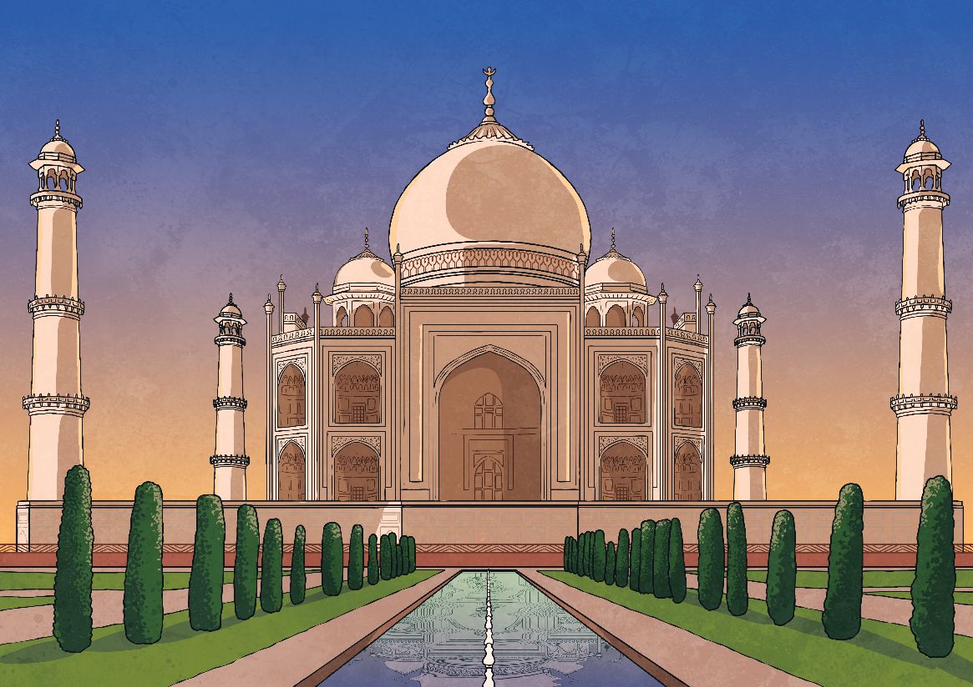
Taj Mahal
The Taj Mahal is located in Agra. It is one of the most popular tourist sites in India.
It is a world-famous site and a burial chamber for the wife of an emperor.
The Taj Mahal is constructed from white marble.
It is one of the new Seven Wonders of the World.

