Slide 1
Year 2
2D and 3D Shapes
Monday

Slide 2
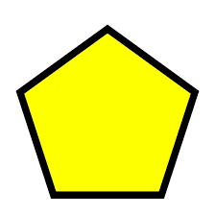
Can you name all of these shapes?
Pentagon
Square
Rectangle
Triangle
Hexagon
Octagon

Slide 3
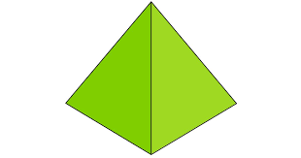
Cube
Cylinder
Cone
Cuboid
square-based Pyramid

Slide 4
What about these two shapes?
Sphere
Circle
This is a 3D shape
This is a 2D shape

Slide 5
1. Watch this BBC Bitesize video to remind yourself about what a 2D shape is.
https://www.youtube.com/watch?v=OVItzLoovLc
2. Now, check yourself!
What do most 2D shapes have?
A.
Corners and sides
Are 2D shapes flat?
Yes
B.
Corners, but no sides
C.
Sides, but not corners

Slide 6
1. Explore this fun BBC Bitesize video about 3D shapes.
https://www.bbc.co.uk/bitesize/topics/zjv39j6/articles/zcsjqty
2. Check yourself!
3D shapes have the following dimensions
Are 3D shapes flat?
No
A.
length and depth
B.
length, depth and width
C.
depth and width

Slide 7
Have a go at sorting the following shapes
2D shape | 3D shape

Slide 8
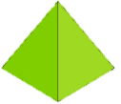
How did you get on?
2D shape | 3D shape

Slide 9
Today, there are 2 challenges for you to choose from.
You can choose to do either the first one, or the second one.
You can also choose to do both.

Slide 10
Challenge 1
Here are some examples of the repeating patterns
1.
2.

Slide 11
How many different ways can you arrange these shapes to make a repeating pattern?
(If you exit the Slide Show mode you can do it on a screen, alternatively you can either draw them or print the pictures out)

Slide 12
Challenge 2
Go for a walk. Can you spot all these shapes outside? Every time you spot the shape give it a tick in the box.
You can print this page out or you can copy the table on a paper. The main task is for children to observe and practice
spotting different shapes around them.
Shape | Every time you spot the shape give it a tick

Slide 13
Well done, Year 2!
Amazing shape detective work today!

Slide 14
Year 2
Counting sides and vertices on a 2D shape
Tuesday

Slide 15
Let’s recap
What is a 2D shape?
That’s right. 2D shape is a flat shape. It has sides and corners.
Give me 3 examples of a 2D shape.

Slide 16
What shape is this?
That’s right. This is a triangle.
I know that a triangle has 3 sides.
What is a side? Discuss
Can you show me the sides of a triangle?

Slide 17
Watch me
I know that a triangle has three sides.
This is one side.
This is a third side
This is a second side.
I made sure that I counted one side at a time and one by one, without jumping or missing a side.
This way I am making sure I do not make a mistake when counting.

Slide 18
Your turn
Count the sides of these shapes. Remember: count one side at a time. Do not skip any.
Name | Shape | Number of sides
Pentagon
Rectangle
Square
Triangle
Hexagon
5
4
Did you get them all right?
Give yourselves a thumbs up!
4
3
6

Slide 19
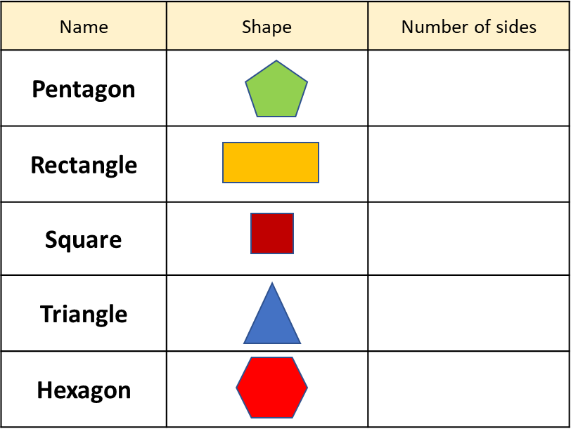
This is curious! I counted that a triangle has three sides
but I also know that the word “tre” in Latin means “three”
Can you find out why the shapes have the names that they do?
I will reveal the answers at the beginning of the next lesson!
5
4
4
3
6

Slide 20
We looked at the sides of the 2D shapes. Now, let’s think about the corners.
Can you show me the corners on this triangle?
Can you explain what a corner is?
The point where two lines meet is called a corner or a vertex.
In maths we do not use the word ‘corner’, instead we say vertex. Can you say vertex?
Instead of saying ‘corners’ we say ‘vertices’!

Slide 21
Your turn
1. Can you find any 2D shapes around your house? Count how many vertices the shapes have.
2.
Put these shapes in order based upon the number of vertices they have.

Slide 22
Well done Year 2!
Excellent maths work today!

Slide 23
Year 2
Making 3D shapes
Wednesday

Slide 24
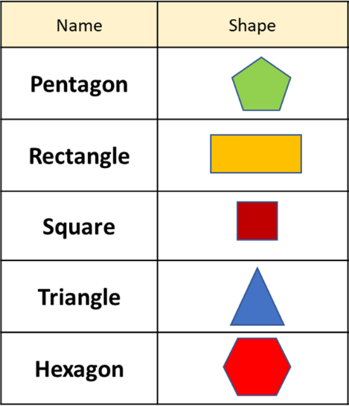
Did you find out about the names of the shapes?
The word ‘pente’ comes from Ancient Greek and means ‘five’
The word comes from Latin ‘rectangulus’ and means straight angled.
The word comes from Old French and means right angled.
As we know already, ‘tre’ in Latin means ‘three’
The word comes from ancient Greek and means ‘six-angled’

Slide 25
Let’s recap
What is a 2D shape?
2D shape is a flat shape. It has sides and vertices.
What is a vertex?
Vertex is the point where two lines meet.

Slide 26
What shape am I?
That’s right. I am a pentagon!
I am a 2D shape.
I have 5 vertices.
What am I?
I am a 2D shape.
You are correct! I am an octagon!
I share half of my name with an octopus.
I have 8 sides.
What am I?

Slide 27
Can you explain in your own words what a 3D shape is?
Watch the Monday’s video again:
https://www.bbc.co.uk/bitesize/topics/zjv39j6/articles/zcsjqty

Slide 28
Your task for today is to create as many 3D shapes as you can.
You will need toothpicks, popsticks or any other sticks that are of an equal length
to make the following 3D shapes.
If you have some playdough or blu tack, you can use it to stick the corners together.
You are going to use these shapes in the next two lessons.

Slide 29
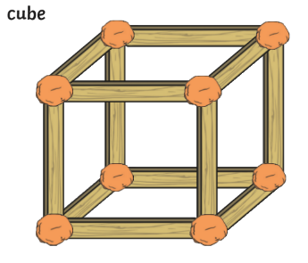
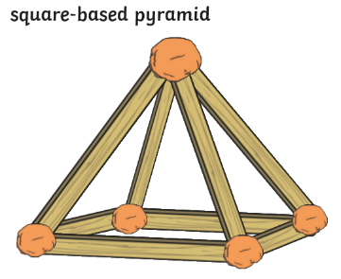

Slide 30
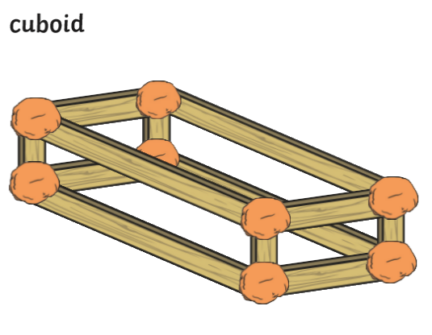

Slide 31
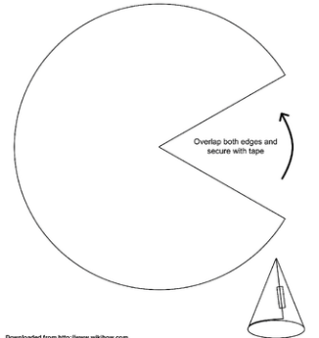
For the last two shapes you will need scissors, a sheet of paper, a pencil and a glue or Sellotape.
Cone
Find a large object (like a pot) to draw around, so you have a circle. Now cut it out.
Then, cut out a ‘slice’ like shown on the picture below. Next, overlap both sides and secure with a tape.

Slide 32
Cylinder
If you have a cardboard tube of any kind at home you can use it for tomorrow’s lesson.
If not, then simply roll the sheet of paper into a tube and secure it with a tape.

Slide 33
Good job, Year 2!
High five in the air

Slide 34
Year 2
Properties of the 3D shapes
Thursday

Slide 35
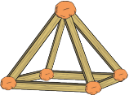
Let’s recap
What is a vertex?
Vertex is the point where two lines meet.
Which shape would not be flat, 2D shape or 3D shape?
That is correct, a 3D shape is not a flat shape.
What is the name of this shape?
square-based pyramid

Slide 36
Today we are going to work with the shapes you created yesterday.
First, let’s watch this BBC Bitesize video
https://www.bbc.co.uk/bitesize/topics/zjv39j6/articles/zgqpk2p

Slide 37
Which 3D shape properties were mentioned in the video?
Faces, edges and vertices.
What is a face of a shape? Use one of your shapes to show me
A face is a flat or curved surface of a shape.
Do you remember how many faces did the cube have in the video?
6
Find the cube you made yesterday. Count how many faces your cube has.
Also 6, right?

Slide 38
Your turn
Explore all the shapes you made yesterday. Count how many faces each shape has.
What about the cone? How many faces does the shape have?
Once you are finished check your answers.
 | Name of the shape | Number of faces
 | cylinder | 3 (1 curved surface and 2 faces)
 | cube | 6
 | square-based pyramid | 5
 | cone | 2( 1 curved surface and one face)
 | cuboid | 6

Slide 39
We know that faces are flat or curved surfaces.
An edge is where the two faces meet. Have a go at showing the edges on the cube.
Let’s check
Did you get 12 edges? Well done.
How did you make sure that you have counted all edges and didn’t count any twice?
Can you check if I have counted and marked all the edges?

Slide 40
Your turn
Explore all the shapes you made yesterday. Count how many edges each shape has.
Once you are finished check your answers.
 | Name of the shape | Number of faces | Number of edges
 | cylinder | 2 (1 curved surface and one face) | 2
 | cube | 6 | 12
 | square-based pyramid | 5 | 8
 | cone | 2( 1 curved surface and one face) | 1
 | cuboid | 6 | 12

Slide 41
Well done, Year 2!
Excellent maths work today!

Slide 42
Year 2
Properties of the 3D shapes
Friday

Slide 43
Let’s recap
Explain what the following words mean:
Side in a 2D shape
Vertex in a 2D shape
Edge in a 3D shape
Face in a 3D shape

Slide 44
Today, we are going to look at the last property of a 3D shape.
Watch BBC Bitesize video again very carefully. Which property of a 3D shape we haven’t explored yet?

Slide 45
What did you notice, which property we haven’t looked at yet?
That’s correct. We need to explore the vertices on a 3D shape.
Do you think you might have an idea of what a vertex in a 3D shape might be?
Take a cube and have a go at showing the vertices on a 3D shape.

Slide 46
Watch me
These are vertices in a cube.
Did you have the same idea?
A vertex in a 3D shape is a point where two or more edges meet.

Slide 47
Your turn
Count how many vertices the shapes you have made have?
Once you are finished check your answers.
 | Name of the shape | Number of faces | Number of edges | Number of vertices
 | cylinder | 2 (1 curved surface and one face) | 2 | 0
 | cube | 6 | 12 | 8
 | square-based pyramid | 5 | 8 | 5
 | cone | 2( 1 curved surface and one face) | 1 | 1
 | cuboid | 6 | 12 | 8

Slide 48
Your task today is to investigate 2D and 3D shapes which stack and which roll.
stack
roll
Sort your shapes using the Venn diagram. Explain what you notice about each set.
Do all shapes with flat surfaces stack?

Slide 49
Amazing shape work this week, Year 2!

