Slide 1
Year 2
Telling the time to o’clock and half past
Tuesday

Slide 2
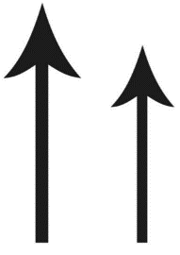
Which of these hands is a minute hand?
That is correct. The long one.
What is the name of a short hand?
The hour hand!

Slide 3
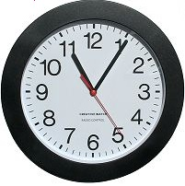
Which way the hands are moving on a clock?
Look at my clock.
What was a special name for this direction?
Clockwise
On your clock, move the hands
clockwise.

Slide 4

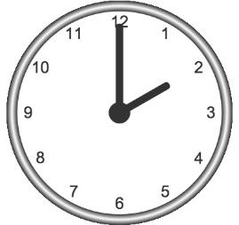
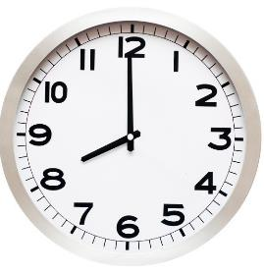

Today, we are going to look at how to tell the time to o’clock and to half past an hour.
This clock is
showing:
2 o’clock
This clock is
showing:
8 o’clock
When the minute (big) hand is pointing to 12, like this:
This means that it is o’clock.
The hour (small) hand is pointing to the hour.

Slide 5
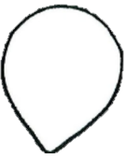
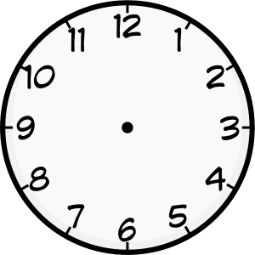
Take the petal that says o’clock and attach it on top of the number 12
o’clock
Like this

Slide 6
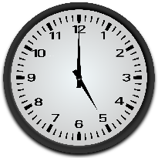
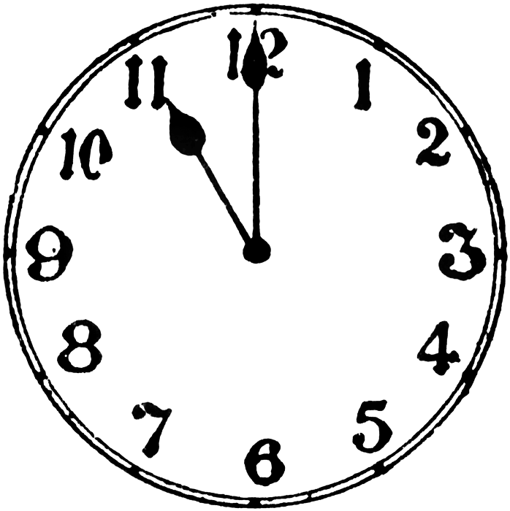
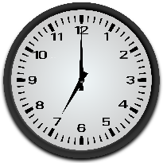
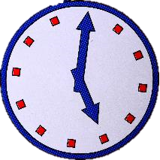
Your turn
1. What time is it?
2. Now, make 3 o’clock, 9 o’clock, 1 o’clock on your clock.
3. Challenge
Can you tell what time it is on this clock? How do you know, explain.

Slide 7

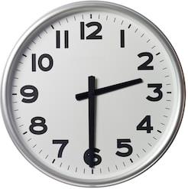
Look at these two clocks. What is different?
This clock shows:
2 o’clock
This clock shows:
Half past 2
What do you notice about the hour hand? Is it still pointing directly to 2?
What about the minute hand? Where is it pointing now?

Slide 8

The minute hand has travelled half way around the clock
and is pointing at the 6
and the hour hand is halfway between the hours
this means that the clock is showing half past the hour.
This clock is showing:
half past 2

Slide 9
Take the petal that says half past and attach it under the number 6
o’clock
Like this
half past

Slide 10
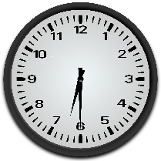
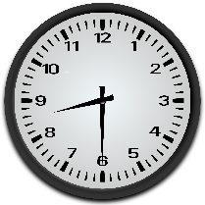
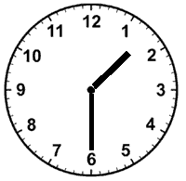
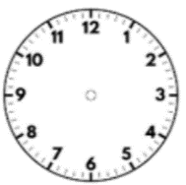
Your turn
1. What time is it?
2. Make half past 3, half past 11 and half past 4 on your clock.
3. Can you spot the mistakes I made?
1.
2.

Slide 11
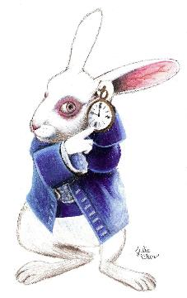
Well done, Year 2!
Amazing work today!

Slide 12
Year 2
Telling the time to quarter past an hour
Wednesday

Slide 13
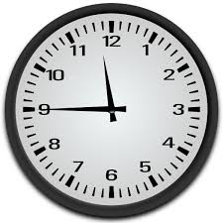
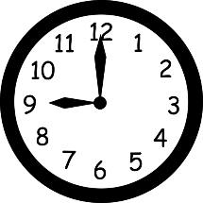
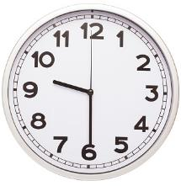
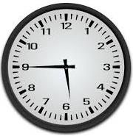
Let’s recap
Which of these clocks is showing half past 9? Explain your thinking.

Slide 14
Who is telling the time correctly? Explain.

Slide 15
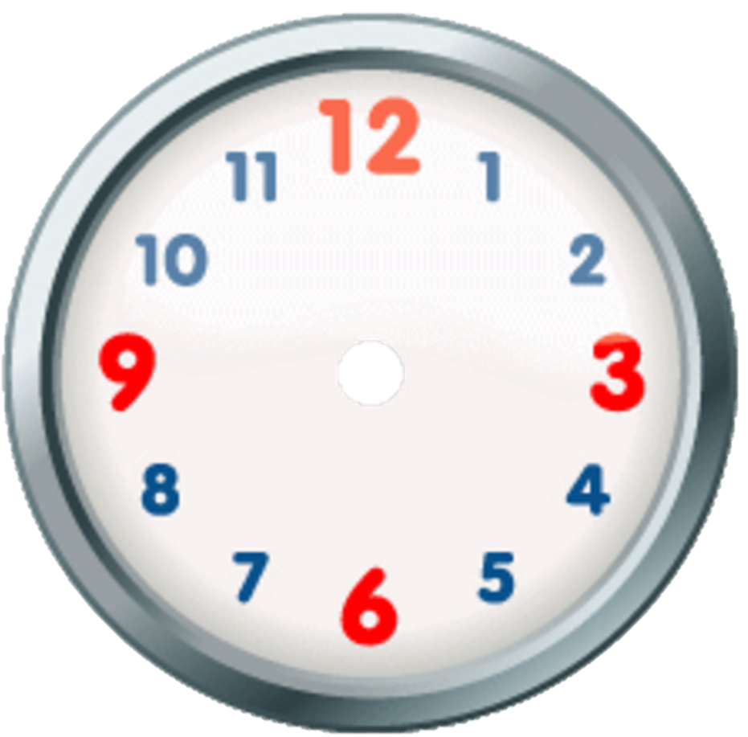
We can divide the clock face into 4 equal parts. Like this:
My shaded part is one out of 4, or a quarter
I remember that both hands
on a clock move clockwise.
Like this:

Slide 16
This means that the minute hand had travelled past o’clock for one quarter of an hour
Minute hand started here, on o’clock
Travelled for a quarter of an hour
and is pointing at the 3
Make this time on
your clock
So, this clock is showing the time:
quarter past 7
The hour clock has moved
slightly from 7.

Slide 17
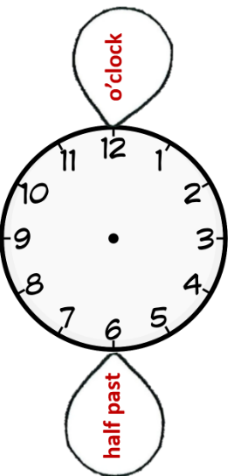
Take the petal that says quarter past and attach it by the number 3
Like this
quarter
past

Slide 18
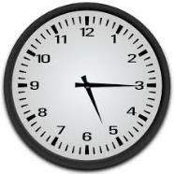
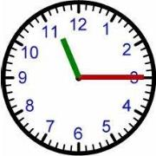
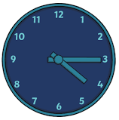
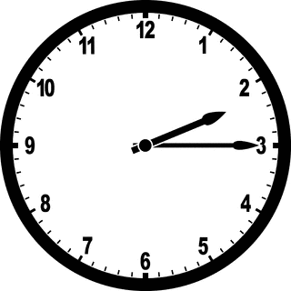
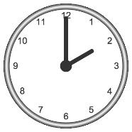
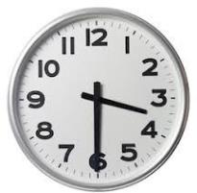
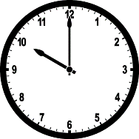
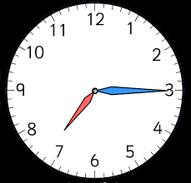
Your turn
Can you tell the time?
2. With your clock make:
quarter past 6
9 o’clock
half past 2
10 o’clock
quarter past 3
quarter past 8

Slide 19
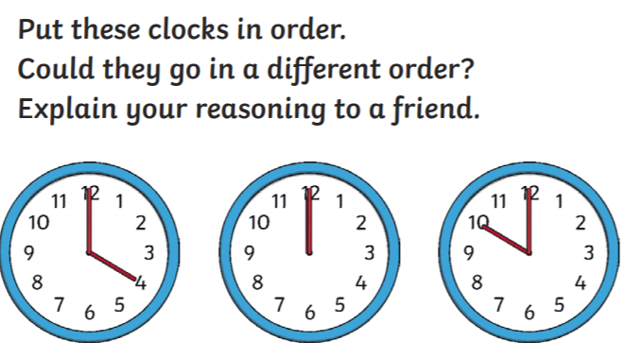
Challenge (optional)

Slide 20

Well done, year 2
Extraordinary maths work today!

Slide 21
Year 2
Telling the time to quarter to an hour
Thursday

Slide 22
Explain in your own words
hour hand
minute hand
clockwise
o’clock
half past an hour
quarter past an hour

Slide 23
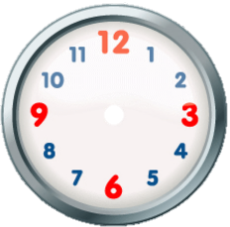

Let’s recap
So far, we have looked at how the minute and the hour hands are travelling clockwise around the clock.
o’clock
When minute hand is pointing at the 12 it is _____________
quarter past
When minute hand is pointing at the 3 it is _______________
half past
When minute hand is pointing at the 6 it is ________________

Slide 24
Where did the minute hand travel to now?
What is it pointing at now?
9
How many parts of the clock are shaded?
3
How many parts are left not shaded?
1

Slide 25
When the minute hand has travelled for 3 out 4 parts of the clock
That means it has one quarter
to go until the new hour
and it is pointing at the 9
The hour hand is nearly pointing to an hour
This clock is showing:
quarter to 5
So, we say quarter to

Slide 26
Take the petal that says quarter to and attach it by the number 9
Like this
quarter
to
quarter
past

Slide 27

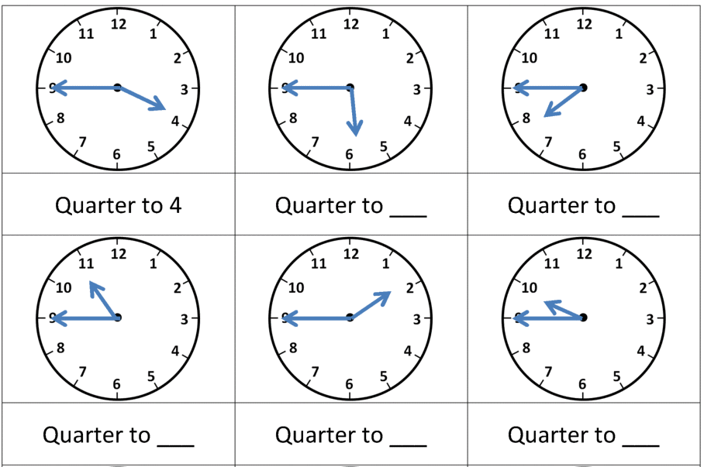
1. What’s the time?
2. With your clock make:
quarter past 4
2 o’clock
half past 9
quarter to 6
11 o’clock
quarter past 8
quarter to 5

Slide 28
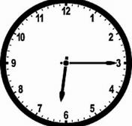
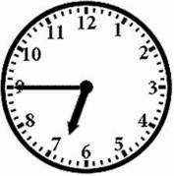
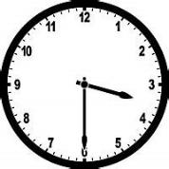
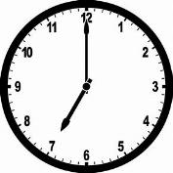
Your turn
Match the clocks with the correct time
quarter to 7
half past 3
quarter past 6
seven o’clock

Slide 29
Excellent maths work today,
year 2
Say to yourself: “I am amazing!”

